Slide 1
Petroleum Storage Tank Trust Fund
– How to Become Eligible –
– Tips on the Reimbursement Process –
Office of Land Resources, Assessment & Remediation

Slide 2
REQUIREMENTS FOR TRUST FUND COVERAGE OF AN
ACCIDENTAL RELEASE
At the time of the discovery of the release the owner or operator must have registered the tanks and paid the annual tank fees
The Department must have been given timely notice of the release as required by federal regulations (within 24 hours)
The owner or operator must cooperate fully with the Department in conducting corrective action to address the release
The owner or operator must have expended $7,500 in reasonable, allowable, and necessary corrective action costs

Slide 3
From September 1, 2017 through September 1, 2018, 14 confirmed releases were reviewed for trust fund eligibility
0 WERE DENIED TRUST FUND ELIGIBILITY

Slide 4
Tips for the Reimbursement Application Process
What to Do:
Follow Regulation 12, the Guidelines for Reimbursement of Corrective Action Costs, and the Application Instructions
Submit applications within a timely manner of when the corrective actions were performed
Results:
A timely reimbursement application review process
What NOT to do:
Submit costs that are NOT allowable under Regulation 12 or the Guidelines for Reimbursement
Submit an incomplete application
Submit an application without proper supporting documentation
Results:
Will require additional time for the review process
The application may be submitted for an ADEQ legal review-which will result in further delay in the review process

Slide 5
Common Unallowable Costs that Result in Additional Processing Time
Cost for repairs to the petroleum storage tank system or piping
Loss of fuel
Cost of testing the petroleum storage tank system that was not requested by ADEQ
Mileage costs that are not based on actual miles traveled
Consultant-owned equipment costs that are not pre-approved
Tools of the trade
Disposal of contaminated media without proper waste manifests
Late fees
Reimbursement application preparation costs already included in the allowed flat application charge
Personal protection equipment

Slide 6
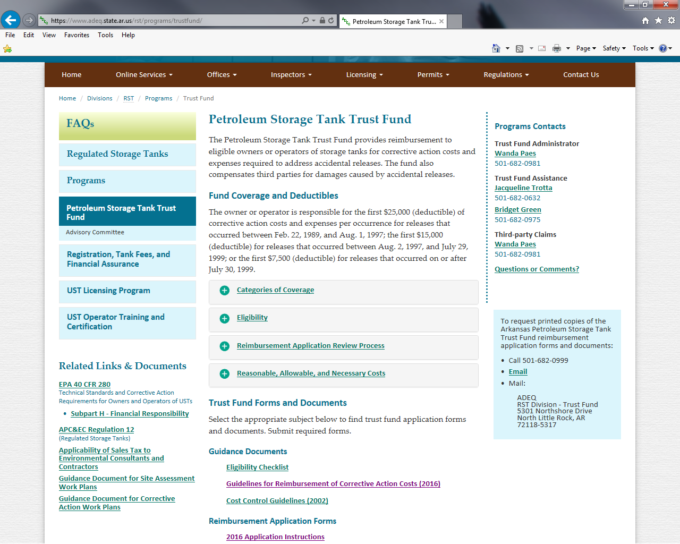
Reimbursement Documents Online
Guidelines and Instructions can be found on the ADEQ webpage: https://www.adeq.state.ar.us/rst/programs/trustfund/

Slide 7
Reimbursement Application Review Process
Each application undergoes two types of reviews :
Technical Review - the applications are reviewed by the remediation case managers to ensure the amounts requested are for work that has been pre-approved in work plans, documented and reported to ADEQ
Financial Review - each application is financially reviewed by the Petroleum Storage Tank Trust Fund staff to ensure that the costs are reasonable, allowable and necessary; supporting documentation for the expenses are verified
ADEQ staff then sends each application for review to the Petroleum Storage Tank Trust Fund Advisory Committee
ADEQ staff, owners or consultants, and Advisory Committee members meet once a month as needed to review and make an approval decision for each application

Slide 8
Reimbursement Application Review Process
ADEQ’s review time goal, from when a complete application is received, until the date of the monthly Advisory Committee meeting is 45 days.
This includes any communication and response time needed from ADEQ to responsible party or their consultant due to minor review questions or changes
Any major issues can cause a delay
From January 1, 2018 through August 31, 2018, the median number of days from receipt at ADEQ to the day of the Advisory Committee meeting was 49 days. This is for all applications, ones that were complete, those that were not complete, and ones that had questionable charges that required further review.

Slide 9
In Conclusion
ADEQ is committed to reviewing, processing, and reimbursing costs to responsible parties as quickly as possible and following the available guidelines will make this possible.
ADEQ believes the Trust Fund should be available to everyone, but we need your help to accomplish this. You must register your tanks, pay the annual tank fees, report a release within 24 hours, and cooperate with the Department in corrective action.

Slide 10
QUESTIONS?
COMMENTS?

Slide 11
Contact info:
Wanda Paes, Trust Fund Manager
501-682-0981
paes@adeq.state.ar.us
Jacqueline Trotta, Trust Fund
501-682-0632
trotta@adeq.state.ar.us
Bridget Green, Trust Fund
501-682-0975
green@adeq.state.ar.us
Jarrod Zweifel, Assessment & Remediation Senior Manager
501-682-0990
zweifel@adeq.state.ar.us

